Slide 1
CS276
Information Retrieval and Web Search
Pandu Nayak and Prabhakar Raghavan
Lecture 15: Web search basics

Slide 2
Brief (non-technical) history
Early keyword-based engines ca. 1995-1997
  Altavista, Excite, Infoseek, Inktomi, Lycos
Paid search ranking: Goto (morphed into Overture.com → Yahoo!)
  Your search ranking depended on how much you paid
  Auction for keywords: casino was expensive!

Slide 3
Brief (non-technical) history
1998+: Link-based ranking pioneered by Google
  Blew away all early engines save Inktomi
  Great user experience in search of a business model
  Meanwhile Goto/Overture’s annual revenues were nearing $1 billion
Result: Google added paid search “ads” to the side, independent of search results
  Yahoo followed suit, acquiring Overture (for paid placement) and Inktomi (for search)
2005+: Google gains search share, dominating in Europe and very strong in North America
  2009: Yahoo! and Microsoft propose combined paid search offering

Slide 4
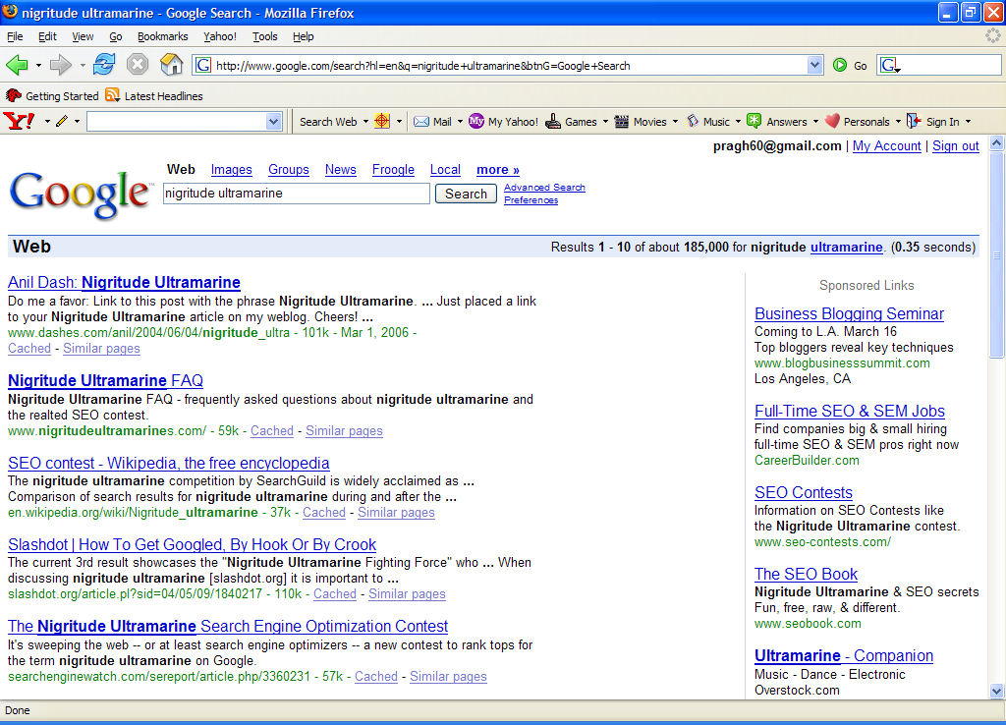
Paid
Search Ads
Algorithmic results.

Slide 5

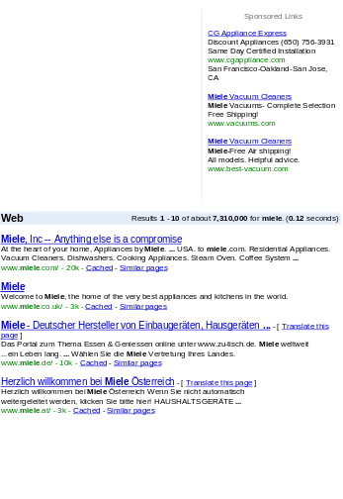

Web search basics
Sec. 19.4.1
User
Web spider
Search
Indexer
The Web
Indexes
Ad indexes

Slide 6
User Needs
Sec. 19.4.1
Need [Brod02, RL04]
  Informational – want to learn about something (~40% / 65%)
  Navigational – want to go to that page (~25% / 15%)
  Transactional – want to do something (web-mediated) (~35% / 20%)
    Access a service
    Downloads
    Shop
  Gray areas
    Find a good hub
    Exploratory search “see what’s there”
Low hemoglobin
United Airlines
Seattle weather
Mars surface images
Canon S410
Car rental Brasil

Slide 7
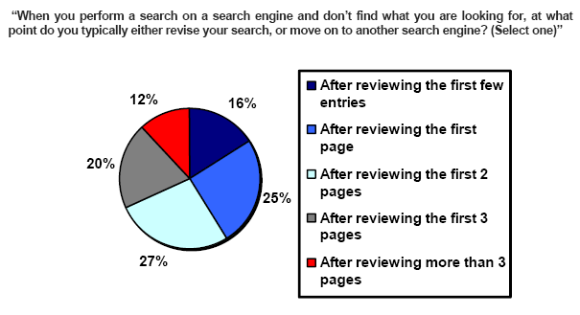
How far do people look for results?
(Source: iprospect.com WhitePaper_2006_SearchEngineUserBehavior.pdf)

Slide 8
Users’ empirical evaluation of results
Quality of pages varies widely
  Relevance is not enough
  Other desirable qualities (non IR!!)
    Content: Trustworthy, diverse, non-duplicated, well maintained
    Web readability: display correctly & fast
    No annoyances: pop-ups, etc.
Precision vs. recall
  On the web, recall seldom matters
What matters
  Precision at 1? Precision above the fold?
  Comprehensiveness – must be able to deal with obscure queries
    Recall matters when the number of matches is very small
User perceptions may be unscientific, but are significant over a large aggregate

Slide 9
Users’ empirical evaluation of engines
Relevance and validity of results
UI – Simple, no clutter, error tolerant
Trust – Results are objective
Coverage of topics for polysemic queries
Pre/Post process tools provided
  Mitigate user errors (auto spell check, search assist,…)
  Explicit: Search within results, more like this, refine ...
  Anticipative: related searches
Deal with idiosyncrasies
  Web specific vocabulary
    Impact on stemming, spell-check, etc.
  Web addresses typed in the search box
“The first, the last, the best and the worst …”

Slide 10
The Web document collection
Sec. 19.2
No design/co-ordination
Distributed content creation, linking, democratization of publishing
Content includes truth, lies, obsolete information, contradictions …
Unstructured (text, html, …), semi-structured (XML, annotated photos), structured (Databases)…
Scale much larger than previous text collections … but corporate records are catching up
Growth – slowed down from initial “volume doubling every few months” but still expanding
Content can be dynamically generated
The Web

Slide 11
SPAM
(SEARCH ENGINE OPTIMIZATION)

Slide 12
The trouble with paid search ads …
Sec. 19.2.2
It costs money. What’s the alternative?
Search Engine Optimization:
  “Tuning” your web page to rank highly in the algorithmic search results for select keywords
  Alternative to paying for placement
  Thus, intrinsically a marketing function
Performed by companies, webmasters and consultants (“Search engine optimizers”) for their clients
Some perfectly legitimate, some very shady

Slide 13
Search engine optimization (Spam)
Sec. 19.2.2
Motives
  Commercial, political, religious, lobbies
  Promotion funded by advertising budget
Operators
  Contractors (Search Engine Optimizers) for lobbies, companies
  Web masters
  Hosting services
Forums
  E.g., Web master world ( www.webmasterworld.com )
    Search engine specific tricks
    Discussions about academic papers ☺

Slide 14
Simplest forms
Sec. 19.2.2
First generation engines relied heavily on tf/idf
  The top-ranked pages for the query maui resort were the ones containing the most maui’s and resort’s
SEOs responded with dense repetitions of chosen terms
  e.g., maui resort maui resort maui resort
  Often, the repetitions would be in the same color as the background of the web page
    Repeated terms got indexed by crawlers
    But not visible to humans on browsers
Pure word density cannot
be trusted as an IR signal

Slide 15
Variants of keyword stuffing
Sec. 19.2.2
Misleading meta-tags, excessive repetition
Hidden text with colors, style sheet tricks, etc.
Meta-Tags =
“… London hotels, hotel, holiday inn, hilton, discount, booking, reservation, sex, mp3, britney spears, viagra, …”

Slide 16
Cloaking
Sec. 19.2.2
Serve fake content to search engine spider
DNS cloaking: Switch IP address. Impersonate
SPAM
Is this a Search
Engine spider?
N
Y
Real
Doc
Cloaking

Slide 17
More spam techniques
Sec. 19.2.2
Doorway pages
  Pages optimized for a single keyword that re-direct to the real target page
Link spamming
  Mutual admiration societies, hidden links, awards – more on these later
  Domain flooding: numerous domains that point or re-direct to a target page
Robots
  Fake query stream – rank checking programs
    “Curve-fit” ranking programs of search engines
  Millions of submissions via Add-Url

Slide 18
The war against spam
Quality signals - Prefer authoritative pages based on:
  Votes from authors (linkage signals)
  Votes from users (usage signals)
Policing of URL submissions
  Anti robot test
Limits on meta-keywords
Robust link analysis
  Ignore statistically implausible linkage (or text)
  Use link analysis to detect spammers (guilt by association)
Spam recognition by machine learning
  Training set based on known spam
Family friendly filters
  Linguistic analysis, general classification techniques, etc.
  For images: flesh tone detectors, source text analysis, etc.
Editorial intervention
  Blacklists
  Top queries audited
  Complaints addressed
  Suspect pattern detection

Slide 19
More on spam
Web search engines have policies on SEO practices they tolerate/block
  http://help.yahoo.com/help/us/ysearch/index.html
  http://www.google.com/intl/en/webmasters/
Adversarial IR: the unending (technical) battle between SEO’s and web search engines
Research http://airweb.cse.lehigh.edu/

Slide 20
DUPLICATE DETECTION
Sec. 19.6

Slide 21
Duplicate documents
Sec. 19.6
The web is full of duplicated content
Strict duplicate detection = exact match
  Not as common
But many, many cases of near duplicates
  E.g., last-modified date the only difference between two copies of a page

Slide 22
Duplicate/Near-Duplicate Detection
Sec. 19.6
Duplication: Exact match can be detected with fingerprints
Near-Duplication: Approximate match
  Overview
    Compute syntactic similarity with an edit-distance measure
    Use similarity threshold to detect near-duplicates
      E.g., Similarity > 80% => Documents are “near duplicates”
      Not transitive though sometimes used transitively

Slide 23
Computing Similarity
Sec. 19.6
Features:
  Segments of a document (natural or artificial breakpoints)
  Shingles (Word N-Grams)
  a rose is a rose is a rose →
  a_rose_is_a
  rose_is_a_rose
  is_a_rose_is
  a_rose_is_a
Similarity Measure between two docs (= sets of shingles)
  Jaccard coefficient: Size_of_Intersection / Size_of_Union

Slide 24
Shingles + Set Intersection
Sec. 19.6
Computing exact set intersection of shingles between all pairs of documents is expensive/intractable
  Approximate using a cleverly chosen subset of shingles from each (a sketch)
Estimate (size_of_intersection / size_of_union) based on a short sketch
Doc A
Shingle set A
Sketch A
Jaccard
Doc B
Shingle set B
Sketch B

Slide 25
Sketch of a document
Sec. 19.6
Create a “sketch vector” (of size ~200) for each document
  Documents that share ≥ t (say 80%) corresponding vector elements are near duplicates
  For doc D, sketch_{D}[ i ] is as follows:
    Let f map all shingles in the universe to 0..2^{m}-1 (e.g., f = fingerprinting)
    Let π_{i} be a random permutation on 0..2^{m}-1
    Pick MIN {π_{i}(f(s))} over all shingles s in D

Slide 26
Computing Sketch[i] for Doc1
Sec. 19.6
Document 1
2⁶⁴
Start with 64-bit f(shingles)
Permute on the number line
with π_{i}
Pick the min value
2⁶⁴
2⁶⁴
2⁶⁴

Slide 27
Test if Doc1.Sketch[i] = Doc2.Sketch[i]
Sec. 19.6
Document 1
Document 2
2⁶⁴
2⁶⁴
2⁶⁴
2⁶⁴
2⁶⁴
2⁶⁴
A
2⁶⁴
B
2⁶⁴
Are these equal?
Test for 200 random permutations: π₁, π₂,… π₂₀₀

Slide 28
However…
Sec. 19.6
Document 1
Document 2
2⁶⁴
2⁶⁴
2⁶⁴
2⁶⁴
A
2⁶⁴
B
2⁶⁴
2⁶⁴
2⁶⁴
A = B iff the shingle with the MIN value in the union of Doc1 and Doc2 is common to both (i.e., lies in the intersection)
Claim: This happens with probability
Size_of_intersection / Size_of_union
Why?

Slide 29
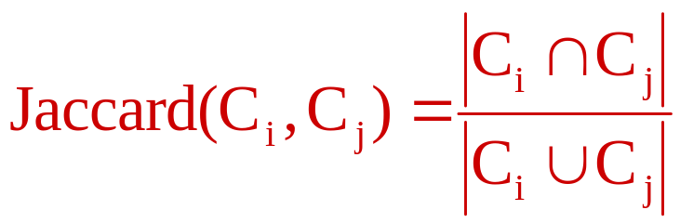
Set Similarity of sets C_{i} , C_{j}
Sec. 19.6
View sets as columns of a matrix A; one row for each element in the universe. a_{ij} = 1 indicates presence of item i in set j
Example
C₁ C₂
0 1
1 0
1 1 Jaccard(C₁,C₂) = 2/5 = 0.4
0 0
1 1
0 1

Slide 30
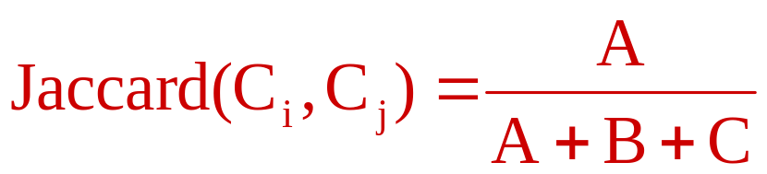
Key Observation
Sec. 19.6
For columns C_{i}, C_{j}, four types of rows
  C_{i} C_{j}
  A 1 1
  B 1 0
  C 0 1
  D 0 0
Overload notation: A = # of rows of type A
Claim

Slide 31
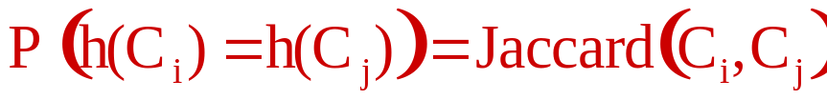
“Min” Hashing
Sec. 19.6
Randomly permute rows
Hash h(C_{i}) = index of first row with 1 in column C_{i}
Surprising Property
Why?
  Both are A/(A+B+C)
  Look down columns C_{i}, C_{j} until first non-Type-D row
  h(C_{i}) = h(C_{j}) ←→ type A row

Slide 32
Min-Hash sketches
Sec. 19.6
Pick P random row permutations
MinHash sketch
Sketch_{D} = list of P indexes of first rows with 1 in column C
Similarity of signatures
  Let sim[sketch(C_{i}),sketch(C_{j})] = fraction of permutations where MinHash values agree
  Observe E[sim(sketch(C_{i}),sketch(C_{j}))] = Jaccard(C_{i},C_{j})

Slide 33
Example
Sec. 19.6
Signatures
S₁ S₂ S₃
Perm 1 = (12345) 1 2 1
Perm 2 = (54321) 4 5 4
Perm 3 = (34512) 3 5 4
C₁ C₂ C₃
R₁ 1 0 1
R₂ 0 1 1
R₃ 1 0 0
R₄ 1 0 1
R₅ 0 1 0
Similarities
1-2 1-3 2-3
Col-Col 0.00 0.50 0.25
Sig-Sig 0.00 0.67 0.00

Slide 34
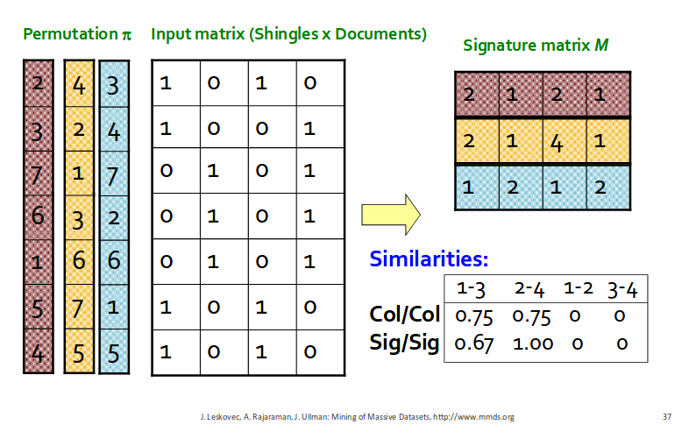
Example

Slide 35
All signature pairs
Sec. 19.6
Now we have an extremely efficient method for estimating a Jaccard coefficient for a single pair of documents.
But we still have to estimate N² coefficients where N is the number of web pages.
  Still slow
One solution: locality sensitive hashing (LSH)
Another solution: sorting (Henzinger 2006)

Slide 36
More resources
IIR Chapter 19

Slide 37
SIZE OF THE WEB

Slide 38
What is the size of the web ?
Sec. 19.5
Issues
  The web is really infinite
    Dynamic content, e.g., calendars
    Soft 404: www.yahoo.com/<anything> is a valid page
  Static web contains syntactic duplication, mostly due to mirroring (~30%)
  Some servers are seldom connected
Who cares?
  Media, and consequently the user
  Engine design
  Engine crawl policy. Impact on recall.

Slide 39
What can we attempt to measure?
Sec. 19.5
The relative sizes of search engines
  The notion of a page being indexed is still reasonably well defined.
  Already there are problems
    Document extension: e.g., engines index pages not yet crawled, by indexing anchortext.
    Document restriction: All engines restrict what is indexed (first n words, only relevant words, etc.)

Slide 40
New definition?
Sec. 19.5
  The statically indexable web is whatever search engines index.
  IQ is whatever the IQ tests measure.
Different engines have different preferences
  max url depth, max count/host, anti-spam rules, priority rules, etc.
Different engines index different things under the same URL:
  frames, meta-keywords, document restrictions, document extensions, ...

Slide 41
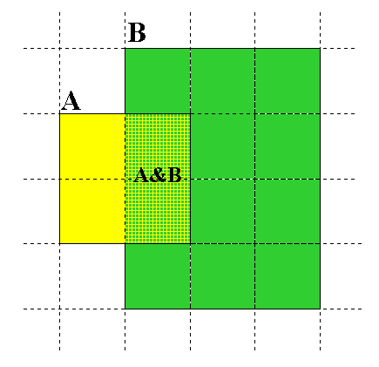
Relative Size from Overlap
Given two engines A and B
Sec. 19.5
Sample URLs randomly from A
Check if contained in B and vice versa
A ∩ B
A ∩ B = (1/2) * Size A
A ∩ B = (1/6) * Size B
(1/2)*Size A = (1/6)*Size B
∴ Size A / Size B =
(1/6)/(1/2) = 1/3
Each test involves: (i) Sampling (ii) Checking

Slide 42
Sampling URLs
Sec. 19.5
Ideal strategy: Generate a random URL and check for containment in each index.
Problem: Random URLs are hard to find! Enough to generate a random URL contained in a given Engine.
Approach 1: Generate a random URL contained in a given engine
  Suffices for the estimation of relative size
Approach 2: Random walks / IP addresses
  In theory: might give us a true estimate of the size of the web (as opposed to just relative sizes of indexes)

Slide 43
Statistical methods
Sec. 19.5
Approach 1
  Random queries
  Random searches
Approach 2
  Random IP addresses
  Random walks

Slide 44
Random URLs from random queries
Sec. 19.5
Generate random query: how?
  Lexicon: 400,000+ words from a web crawl
  Conjunctive Queries: w₁ and w₂
    e.g., vocalists AND rsi
Get 100 result URLs from engine A
Choose a random URL as the candidate to check for presence in engine B
This distribution induces a probability weight W(p) for each page.
Not an English
dictionary

Slide 45
Query Based Checking
Sec. 19.5
Strong Query to check whether an engine B has a document D:
  Download D. Get list of words.
  Use 8 low frequency words as AND query to B
  Check if D is present in result set.
Problems:
  Near duplicates
  Frames
  Redirects
  Engine time-outs
  Is 8-word query good enough?

Slide 46
Advantages & disadvantages
Sec. 19.5
Statistically sound under the induced weight.
Biases induced by random query
  Query Bias: Favors content-rich pages in the language(s) of the lexicon
  Ranking Bias: Solution: Use conjunctive queries & fetch all
  Checking Bias: Duplicates, impoverished pages omitted
  Document or query restriction bias: engine might not deal properly with 8 words conjunctive query
  Malicious Bias: Sabotage by engine
  Operational Problems: Time-outs, failures, engine inconsistencies, index modification.

Slide 47
Random searches
Sec. 19.5
Choose random searches extracted from a local log [Lawrence & Giles 97] or build “random searches” [Notess]
  Use only queries with small result sets.
  Count normalized URLs in result sets.
  Use ratio statistics

Slide 48
Advantages & disadvantages
Sec. 19.5
Advantage
  Might be a better reflection of the human perception of coverage
Issues
  Samples are correlated with source of log
  Duplicates
  Technical statistical problems (must have non-zero results, ratio average not statistically sound)

Slide 49
Random searches
Sec. 19.5
575 & 1050 queries from the NEC RI employee logs
6 Engines in 1998, 11 in 1999
Implementation:
  Restricted to queries with < 600 results in total
  Counted URLs from each engine after verifying query match
  Computed size ratio & overlap for individual queries
  Estimated index size ratio & overlap by averaging over all queries

Slide 50
Queries from Lawrence and Giles study
Sec. 19.5
adaptive access control
neighborhood preservation topographic
hamiltonian structures
right linear grammar
pulse width modulation neural
unbalanced prior probabilities
ranked assignment method
internet explorer favourites importing
karvel thornber
zili liu
softmax activation function
bose multidimensional system theory
gamma mlp
dvi2pdf
john oliensis
rieke spikes exploring neural
video watermarking
counterpropagation network
fat shattering dimension
abelson amorphous computing

Slide 51
Random IP addresses
Sec. 19.5
Generate random IP addresses
Find a web server at the given address
  If there’s one
Collect all pages from server
  From this, choose a page at random

Slide 52
Random IP addresses
Sec. 19.5
HTTP requests to random IP addresses
  Ignored: empty or authorization required or excluded
  [Lawr99] Estimated 2.8 million IP addresses running crawlable web servers (16 million total) from observing 2500 servers.
  OCLC using IP sampling found 8.7 M hosts in 2001
    Netcraft [Netc02] accessed 37.2 million hosts in July 2002
[Lawr99] exhaustively crawled 2500 servers and extrapolated
  Estimated size of the web to be 800 million pages
  Estimated use of metadata descriptors:
    Meta tags (keywords, description) in 34% of home pages, Dublin core metadata in 0.3%

Slide 53
Advantages & disadvantages
Sec. 19.5
Advantages
  Clean statistics
  Independent of crawling strategies
Disadvantages
  Doesn’t deal with duplication
  Many hosts might share one IP, or not accept requests
  No guarantee all pages are linked to root page.
    E.g.: employee pages
  Power law for # pages/hosts generates bias towards sites with few pages.
    But bias can be accurately quantified IF underlying distribution understood
  Potentially influenced by spamming (multiple IP’s for same server to avoid IP block)

Slide 54
Random walks
Sec. 19.5
View the Web as a directed graph
Build a random walk on this graph
  Includes various “jump” rules back to visited sites
    Does not get stuck in spider traps!
    Can follow all links!
  Converges to a stationary distribution
    Must assume graph is finite and independent of the walk.
    Conditions are not satisfied (cookie crumbs, flooding)
    Time to convergence not really known
  Sample from stationary distribution of walk
  Use the “strong query” method to check coverage by SE

Slide 55
Advantages & disadvantages
Sec. 19.5
Advantages
  “Statistically clean” method, at least in theory!
  Could work even for infinite web (assuming convergence) under certain metrics.
Disadvantages
  List of seeds is a problem.
  Practical approximation might not be valid.
  Non-uniform distribution
    Subject to link spamming

Slide 56
Conclusions
Sec. 19.5
No sampling solution is perfect.
Lots of new ideas ...
....but the problem is getting harder
Quantitative studies are fascinating and a good research problem

